Slide 1
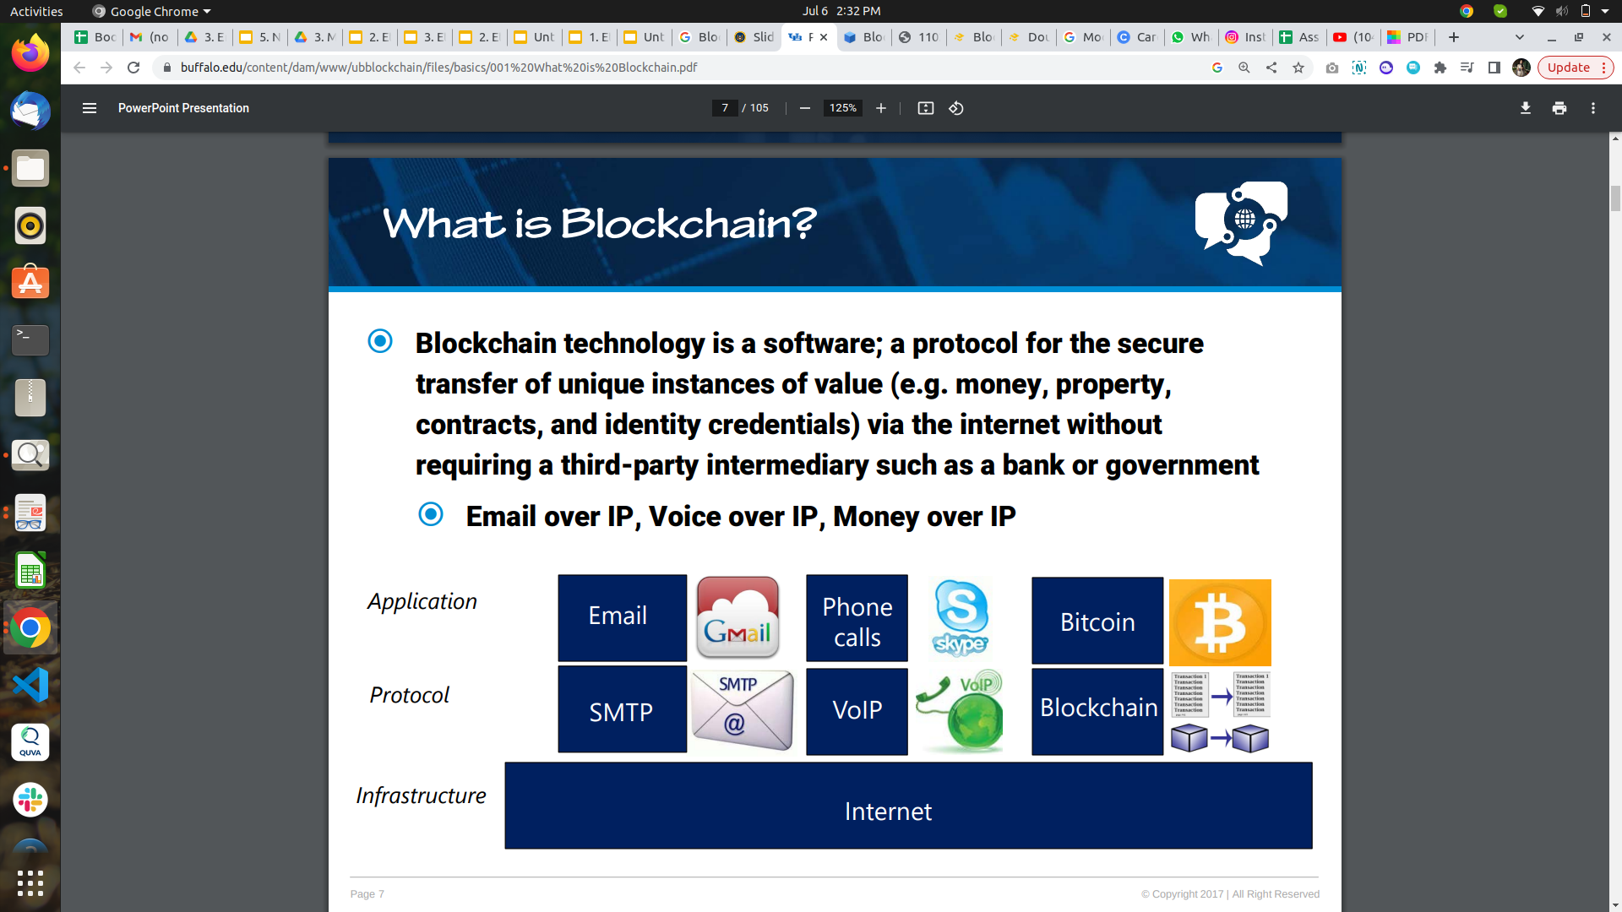

Slide 2
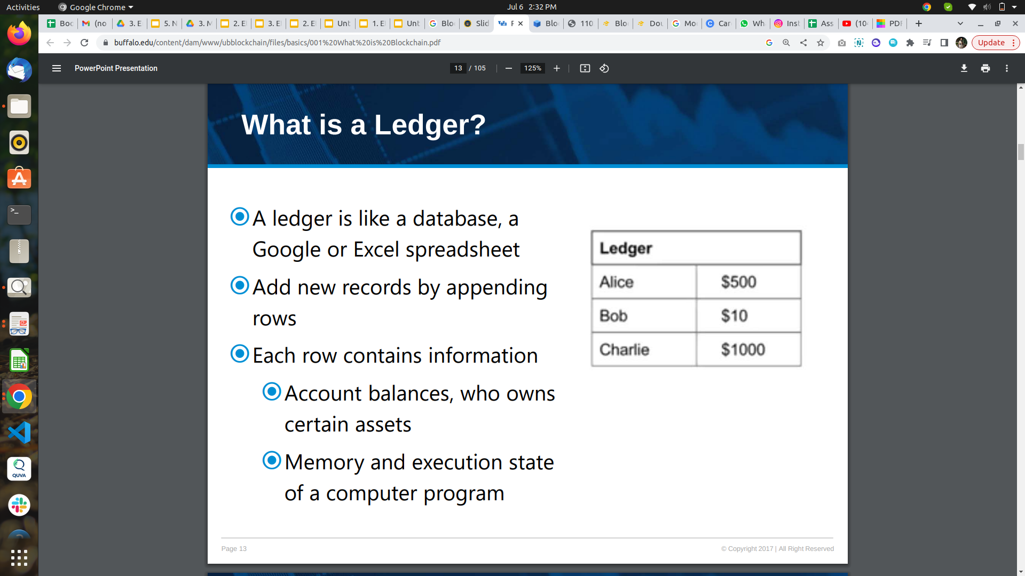

Slide 3
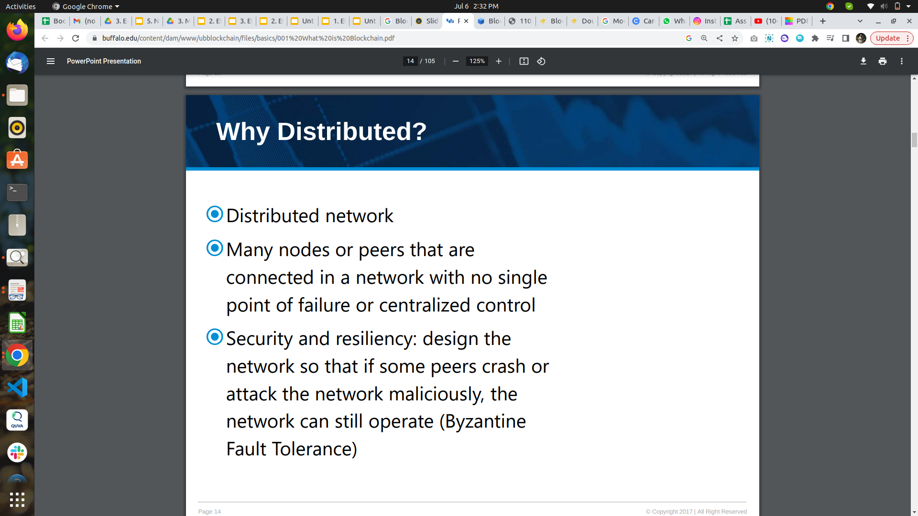

Slide 4
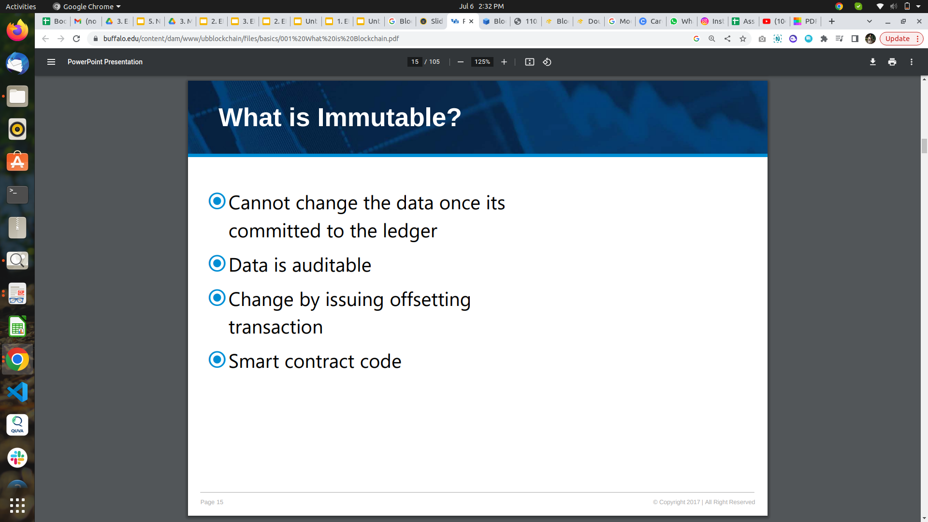

Slide 5
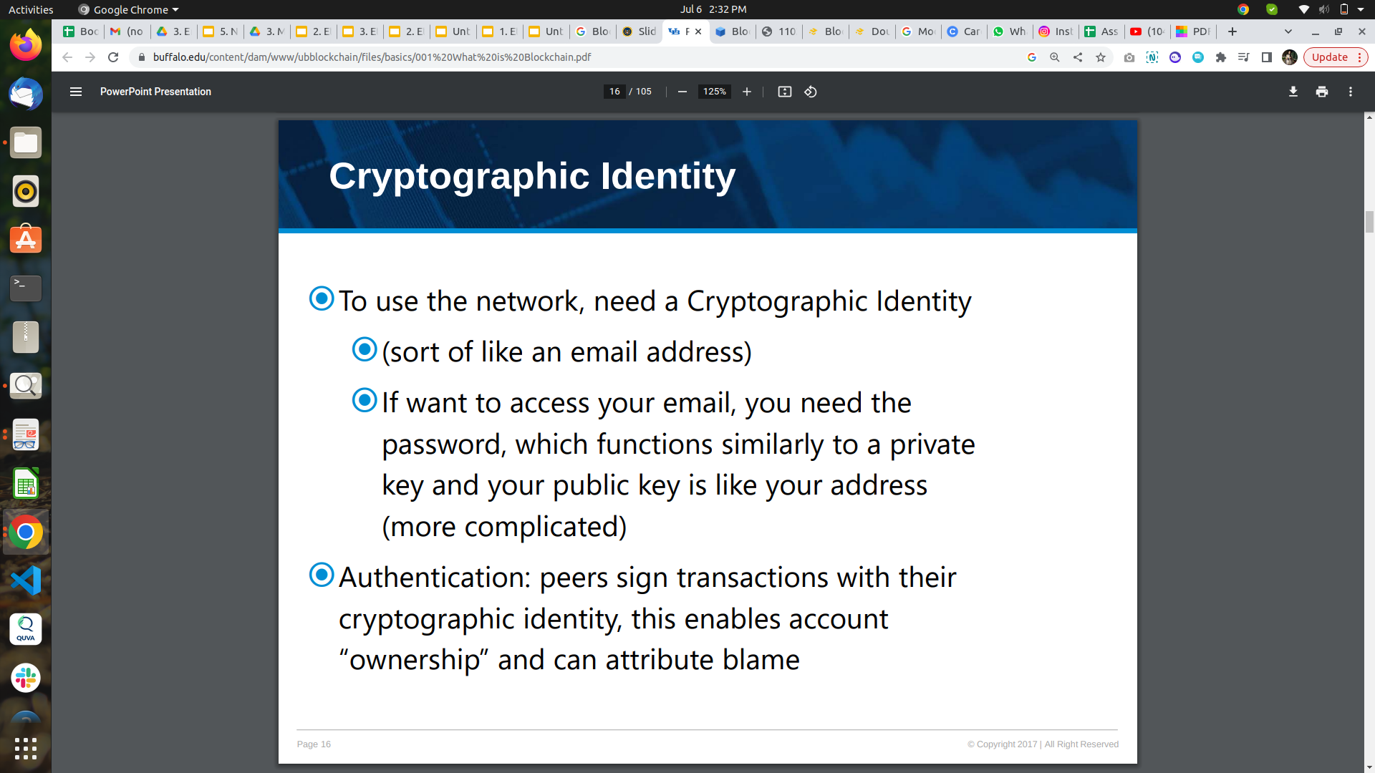

Slide 6
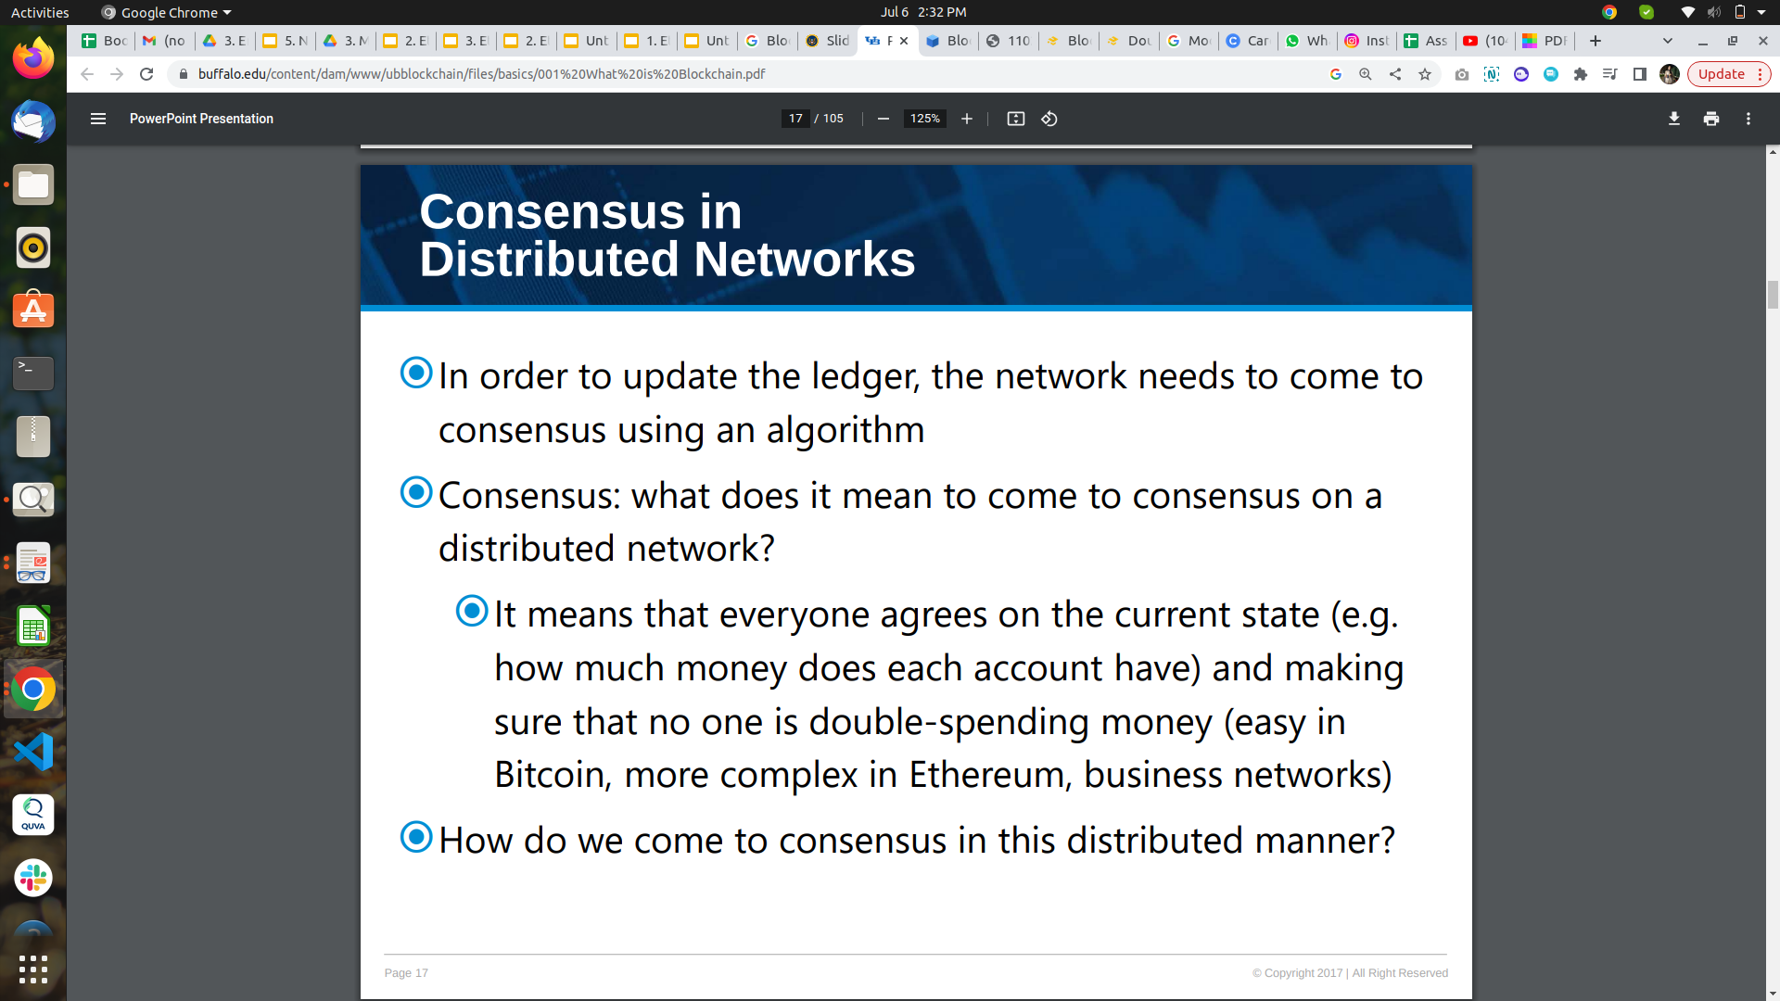

Slide 7
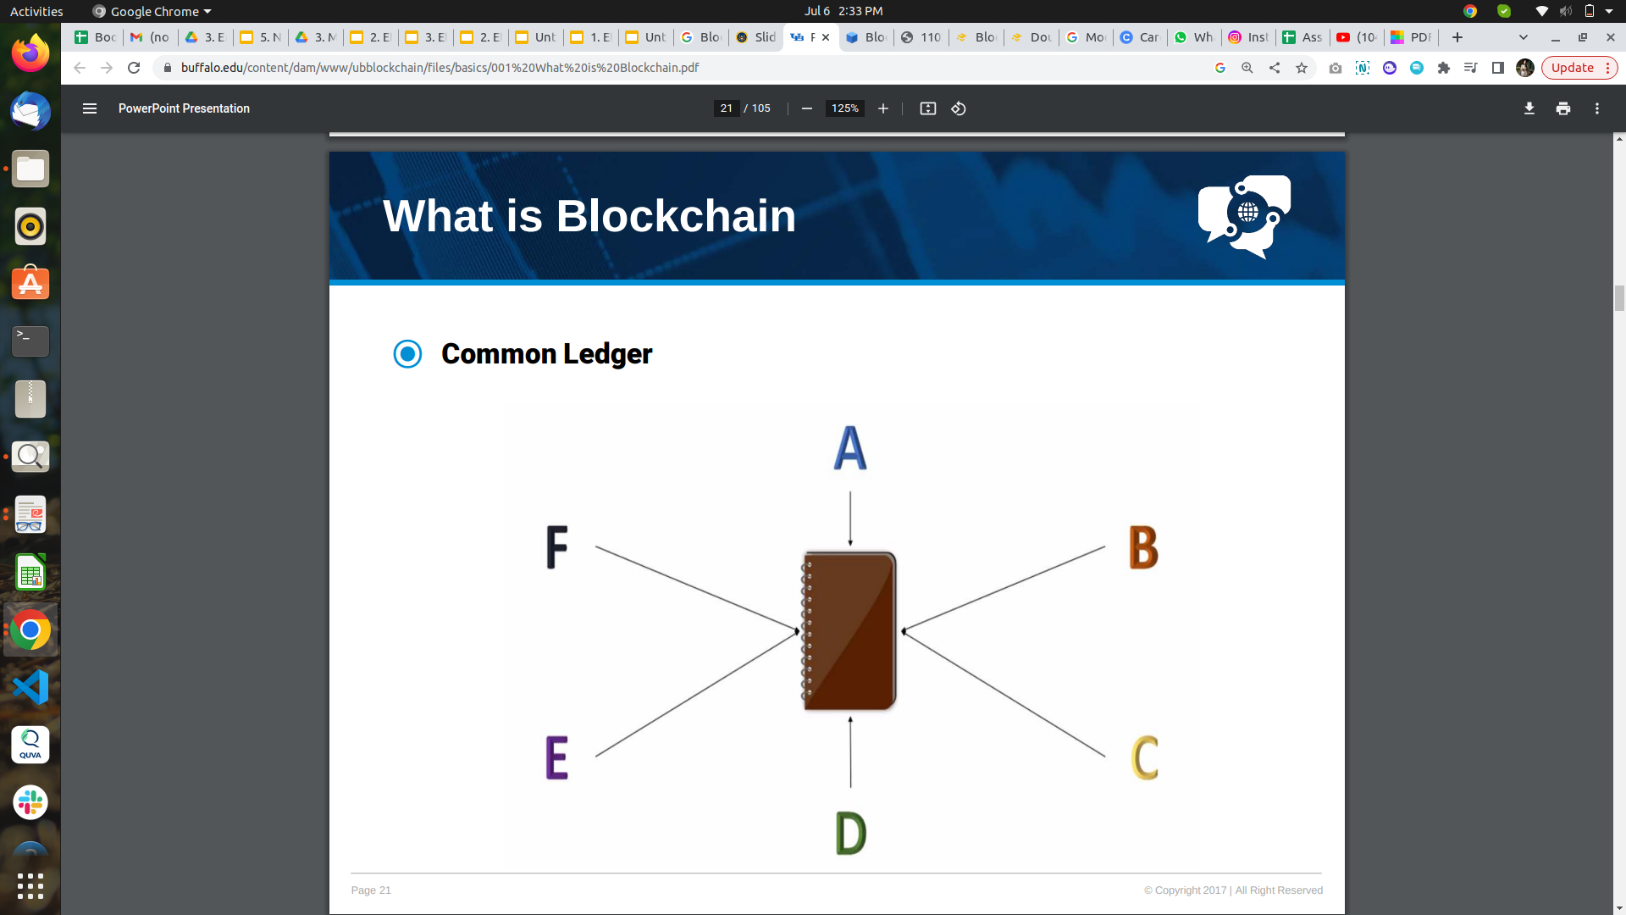

Slide 8
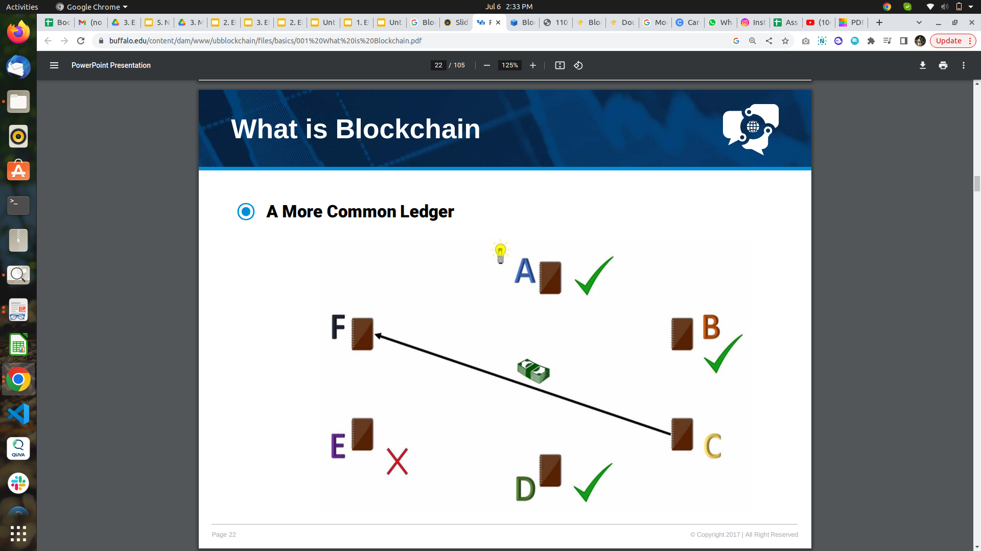

Slide 9
History of Blockchain
1991: In 1991, researcher scientists named Stuart Haber and W. Scott Stornetta introduce Blockchain Technology. These scientists wanted some Computational practical Solution for time-stamping the digital documents so that they couldn’t be tempered or misdated. So both scientists together developed a system with the help of Cryptography. In this System, the time-stamped documents are stored in a Chain of Blocks.
1992: After that in 1992, Merkle Trees formed a legal corporation by using a system developed by Stuart Haber and W. Scott Stornetta with some more features. Hence, Blockchain Technology became efficient to store several documents to be collected into one block. Merkle used a Secured Chain of Blocks that stores multiple data records in a sequence. However, this technology became unused when the Patent came into existence in 2004.

Slide 10
History of Blockchain
2004: In the year 2004, Cryptographic activist Hal Finney introduced a system for digital cash known as “Reusable Proof of Work”. This step was the game-changer in the history of Blockchain and Cryptography. This System helps others to solve the Double Spending Problem by keeping the ownership of tokens registered on a trusted server.
2008: After that 2008, Satoshi Nakamoto conceptualized the concept of “Distributed Blockchain” in his white paper: ”A Peer to Peer Electronic Cash System”. He modified the model of Merkle Tree and created a system that is more secure and contains the secure history of data exchange. His System follows a peer-to-peer network of time stamping. His system became so useful that Blockchain become the backbone of Cryptography.

Slide 11
History of Blockchain
2009: After that, the evolution of Blockchain is steady and promising and became a need in various fields. In 2009, Satoshi Nakamoto Releases Bitcoin White Paper. Blockchain technology is so secure that the following surprising news will give proof of that. A person named, James Howells was an IT worker in the United Kingdom, he starts mining bitcoins which are part of Blockchain in 2009 and stopped this in 2013. He spends $17,000 on it and after he stopped he sells the parts of his laptop on eBay and keep the drive with him so that when he needs to work again on bitcoin he will utilize it but while cleaning his house in 2013, he thrashed his drive with garbage and now his bitcoins cost nearly $127 million. This money now remains unclaimed in the Bitcoin system.

Slide 12
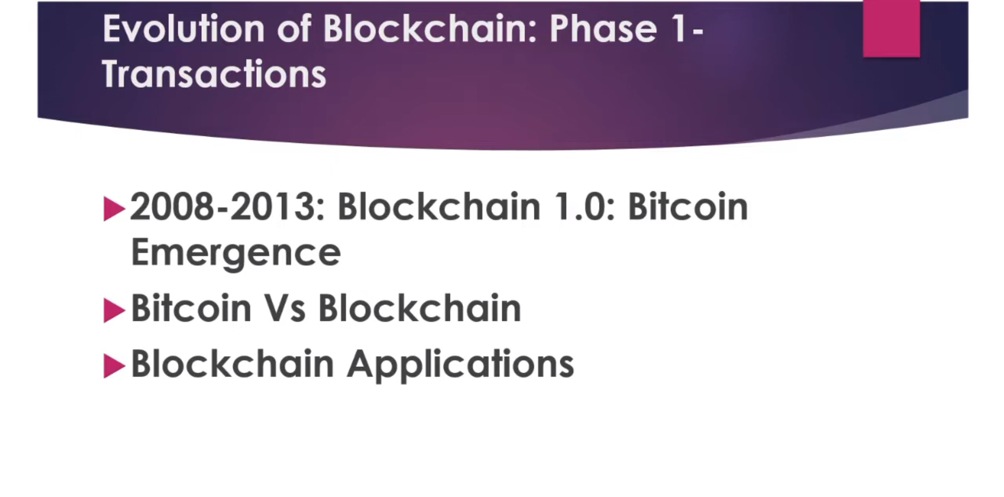

Slide 13
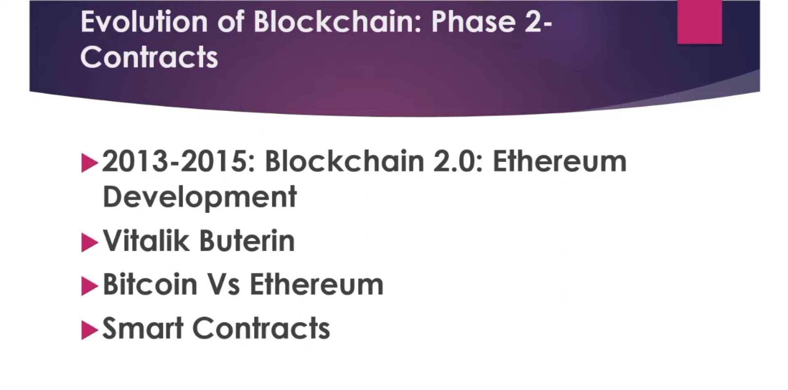

Slide 14
History of Blockchain 2015-2023
2015: In 2015, Ethereum Frontier Network was launched, thus enabling developers to write smart contracts and dApps that could be deployed to a live network. In the same year, the Linux Foundation launched the Hyperledger project.
2016: The word Blockchain is accepted as a single word instead of two different concepts as they were in Nakamoto’s original paper. The same year, a bug in the Ethereum DAO code was exploited resulting in a hard fork of the Ethereum Network. The Bitfinex bitcoin exchange was hacked resulting in 120,000 bitcoin being stolen.
2017: In the year 2017, Japan recognized Bitcoin as a legal currency. Block.one company introduced the EOS blockchain operating system which was designed to support commercial decentralized applications.
2018: Bitcoin turned down in the year 2018. The bitcoin value continued to drop, reaching
the value of $3,800 at the end of the year. Online platforms like Google, Twitter,
and Facebook banned the advertising of cryptocurrencies.

Slide 15
History of Blockchain 2015-2022
2019: In the year 2019, Ethereum network transactions exceeded 1 million per day. Amazon announced the general availability of the Amazon Managed Blockchain service on AWS.
2020: Stablecoins were in demand as they promised more stability than traditional cryptocurrencies. The same year Ethereum launched Beacon Chain in preparation for Ethereum 2.0.
2022 : Ethereum has shifted from Proof of Work(PoW) to Proof of Stake(PoS) consensus mechanism. The original Ethereum mainnet merged with Beacon Chain which has Proof-of-Stake. Now it is existing as one chain. Ethereum’s energy
consumption has reduced by ~99.95%.

Slide 16
Definition?
Let's build our own definition
It’s a decentralized database which stores information in the form of transactions
It can be public or private
Stored data is Immutable
Highly secure
Data gets recorded via consensus based algorithms
Uses cryptography
Generally exist over peer-to-peer network
So here is our definition:
“Blockchain is a consensus-based secure decentralized public/private database which stores information immutably over peer-to-peer network”

Slide 17
Definition?
A blockchain, by design, is resistant to the modification of data. The ledger can record transactions between two parties in a verifiable and permanent way.
Whenever there is a change in the ledger using transactions, changes are distributed to all the nodes, to verify and update their own copy of the ledger. Once a transaction is stored and verified by all the nodes in the network, then it is not feasible to change the transaction without altering all the subsequent and previous blocks.
That's why blockchain transactions are irreversible, as blockchain transactions and their data are append only.

Slide 18
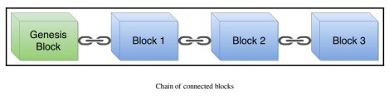
Definition?
Each computer that participates in this P2P network is called a node. Each node maintains the records of transactions in multiple consecutive blocks.
Blockchain technology is also called Decentralized Ledger Technology (DLT), as each node in the network keeps the same copy of the ledger. Please have a look at the following diagram

Slide 19
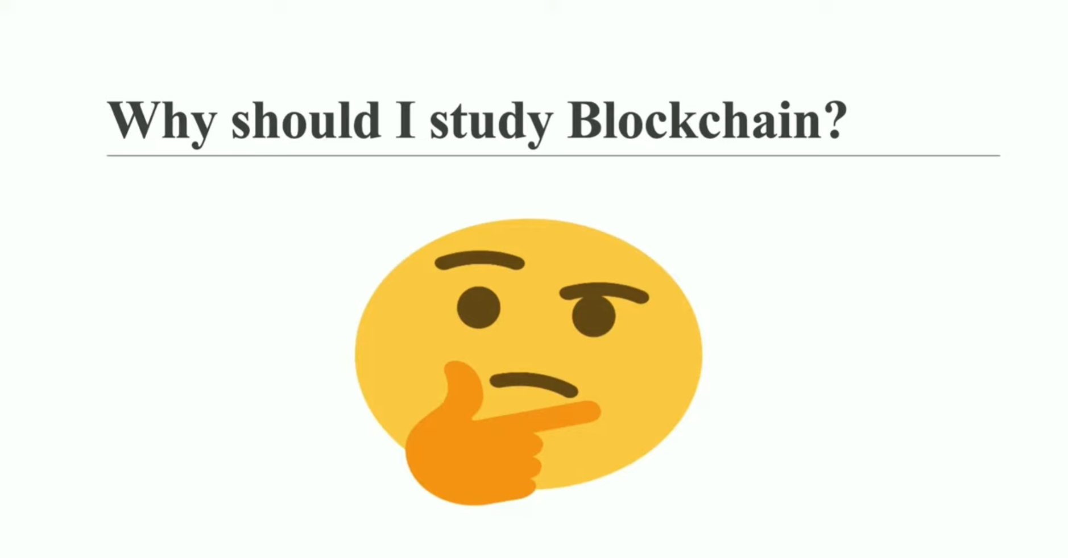

Slide 20
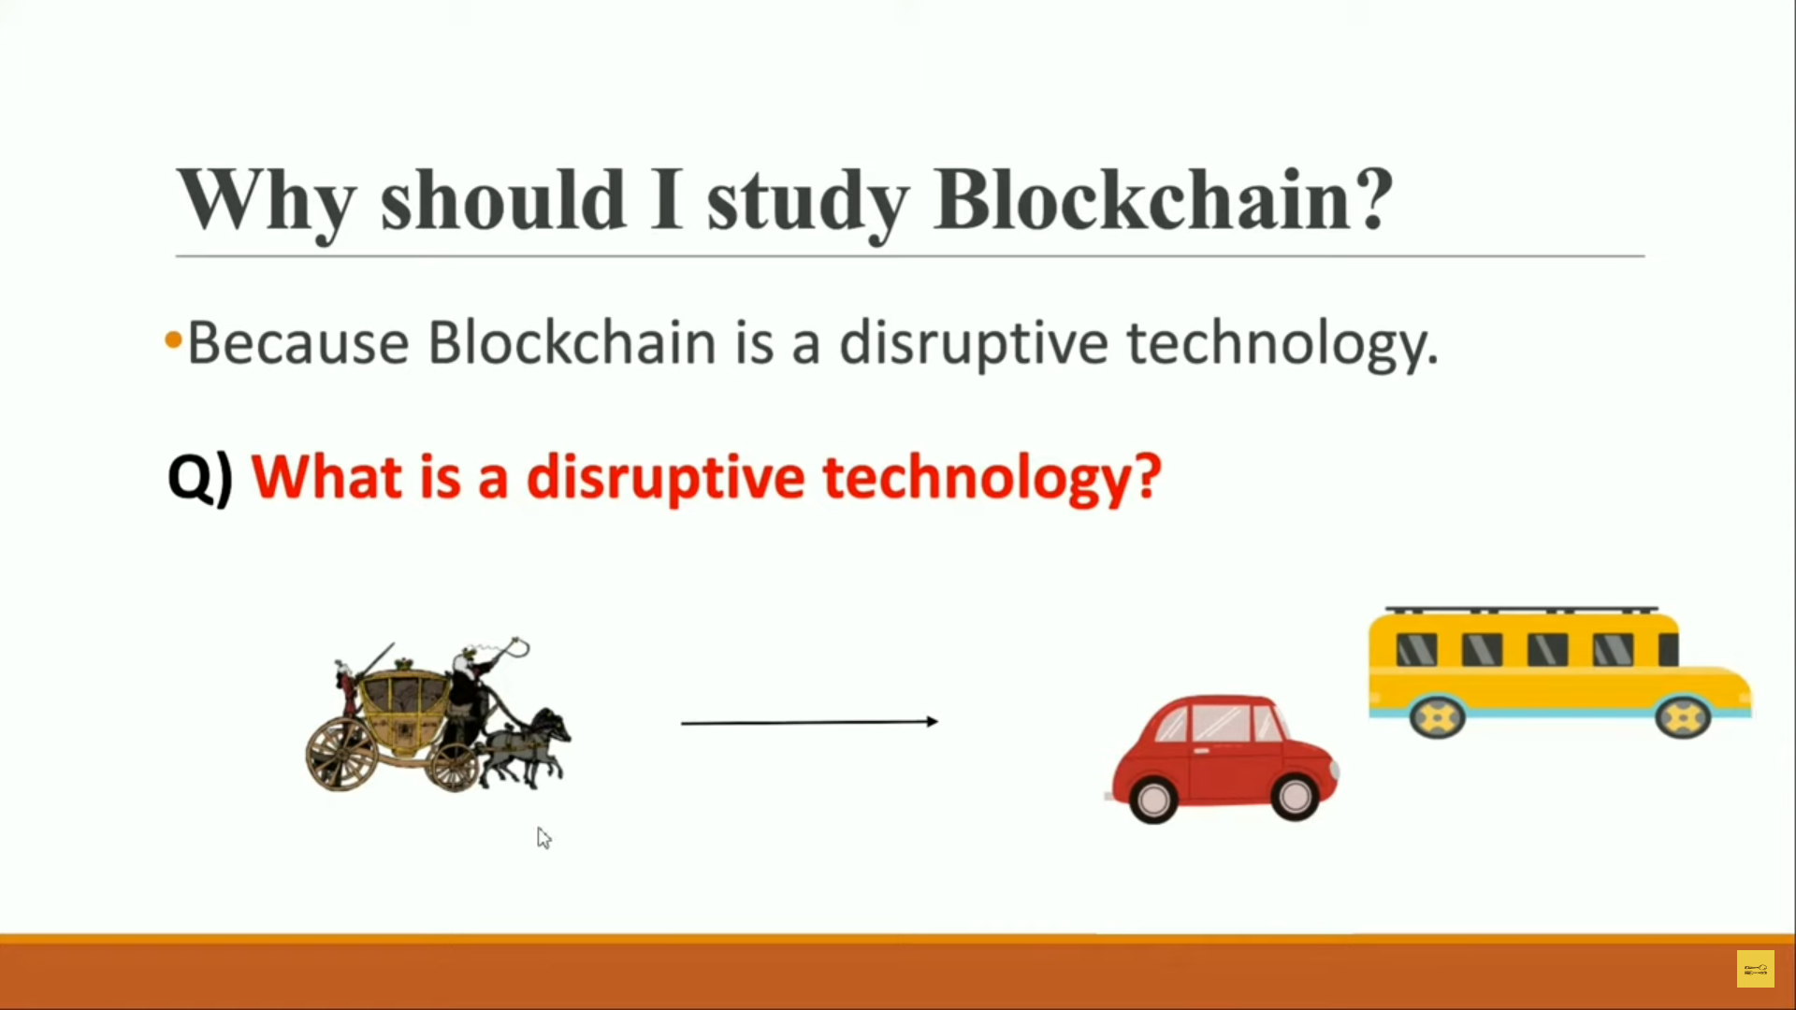

Slide 21
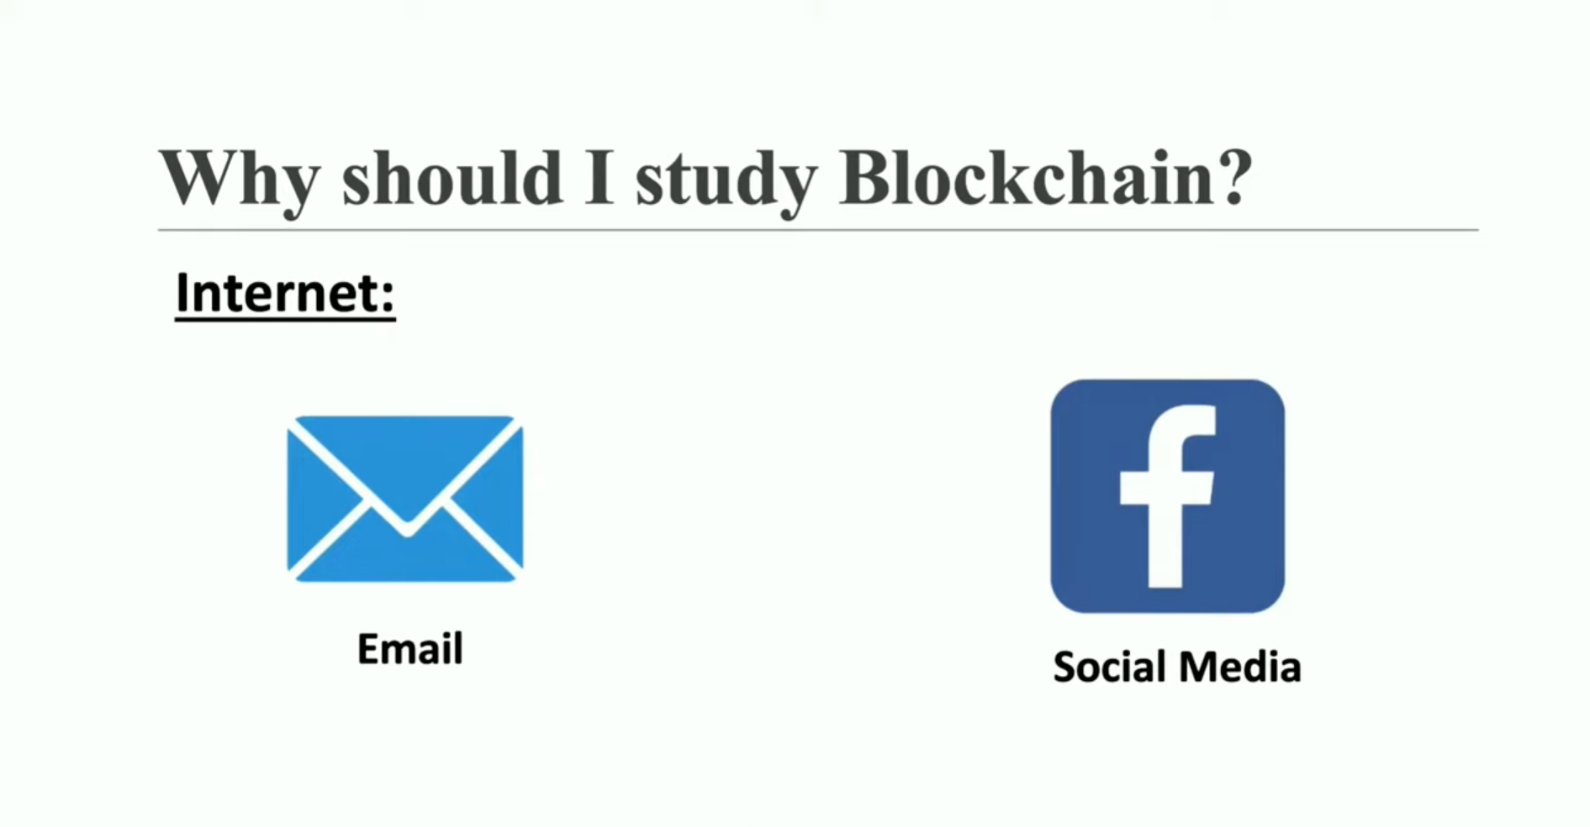

Slide 22
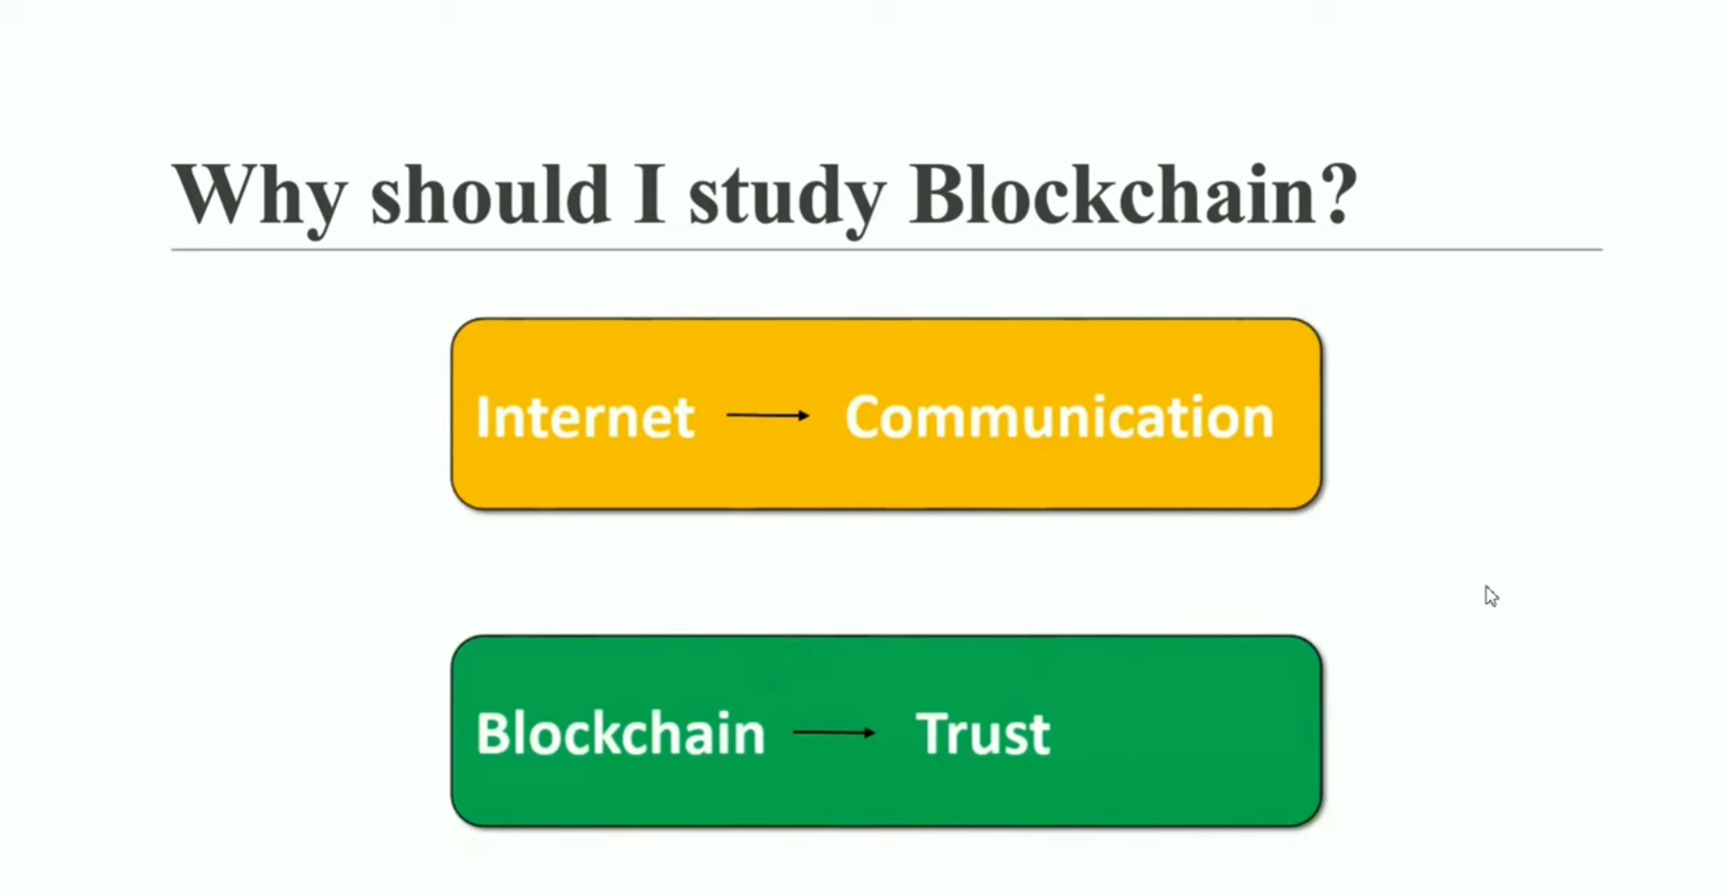

Slide 23
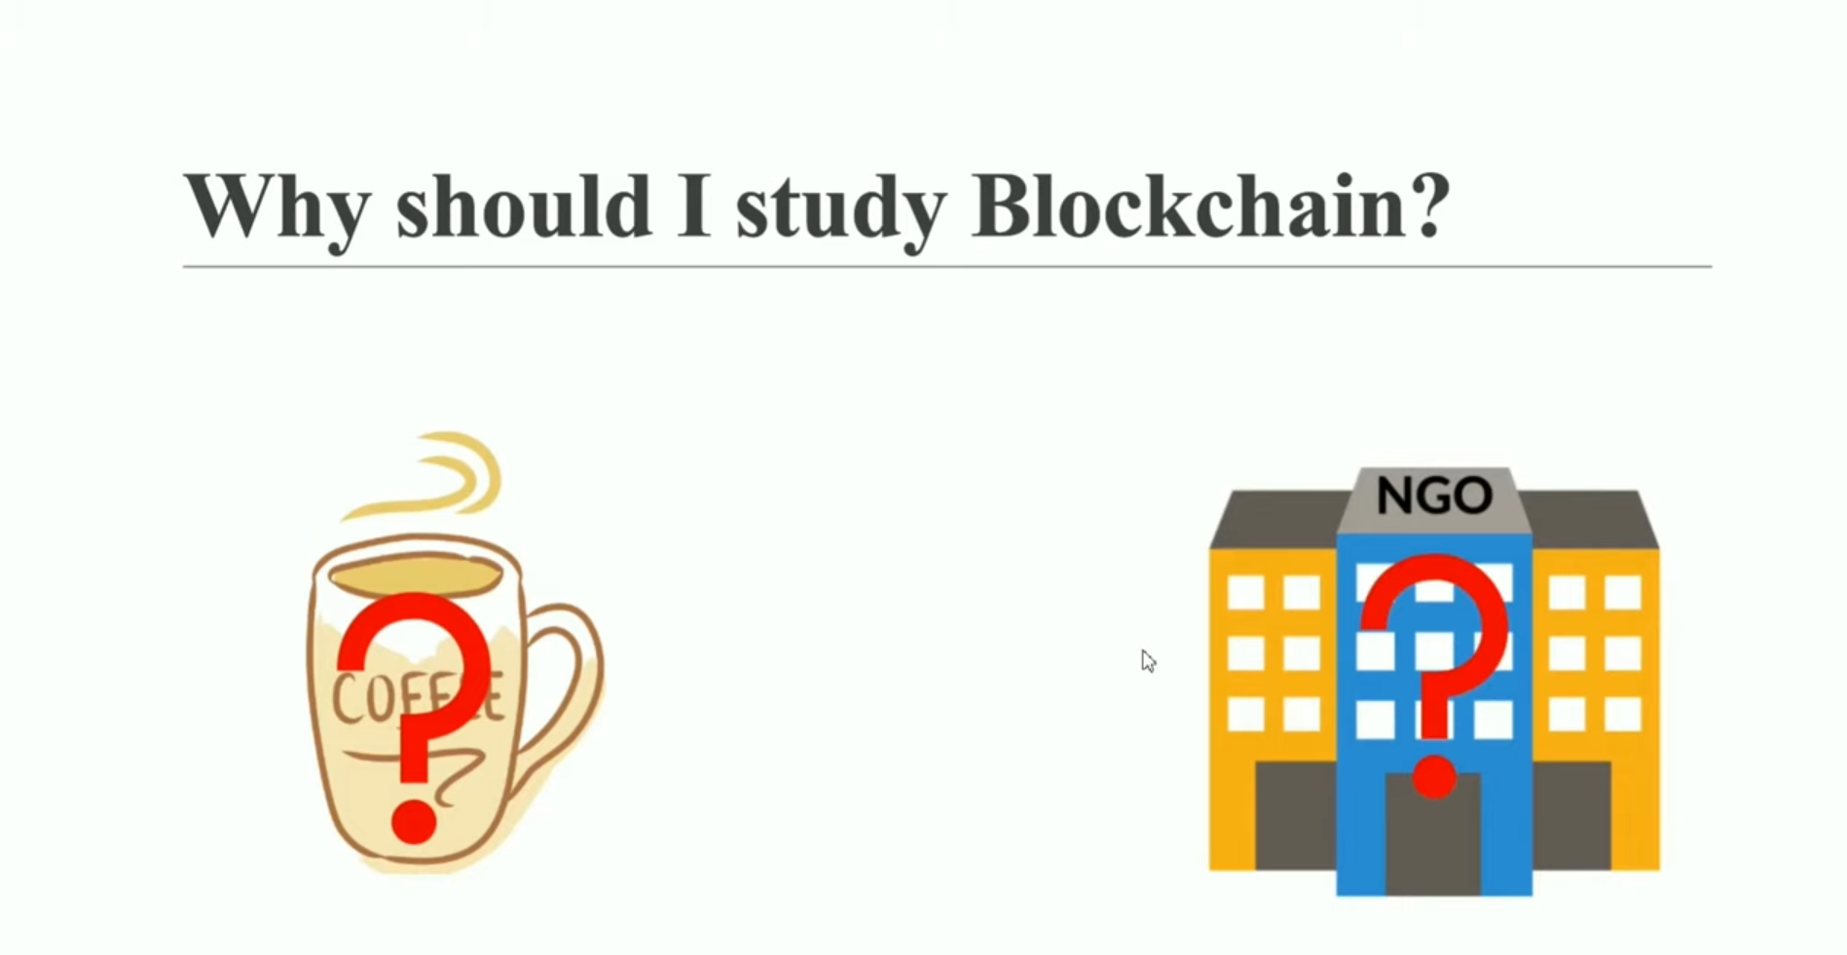

Slide 24
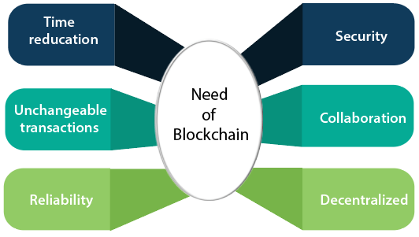
Need of Blockchain

